Slide 1
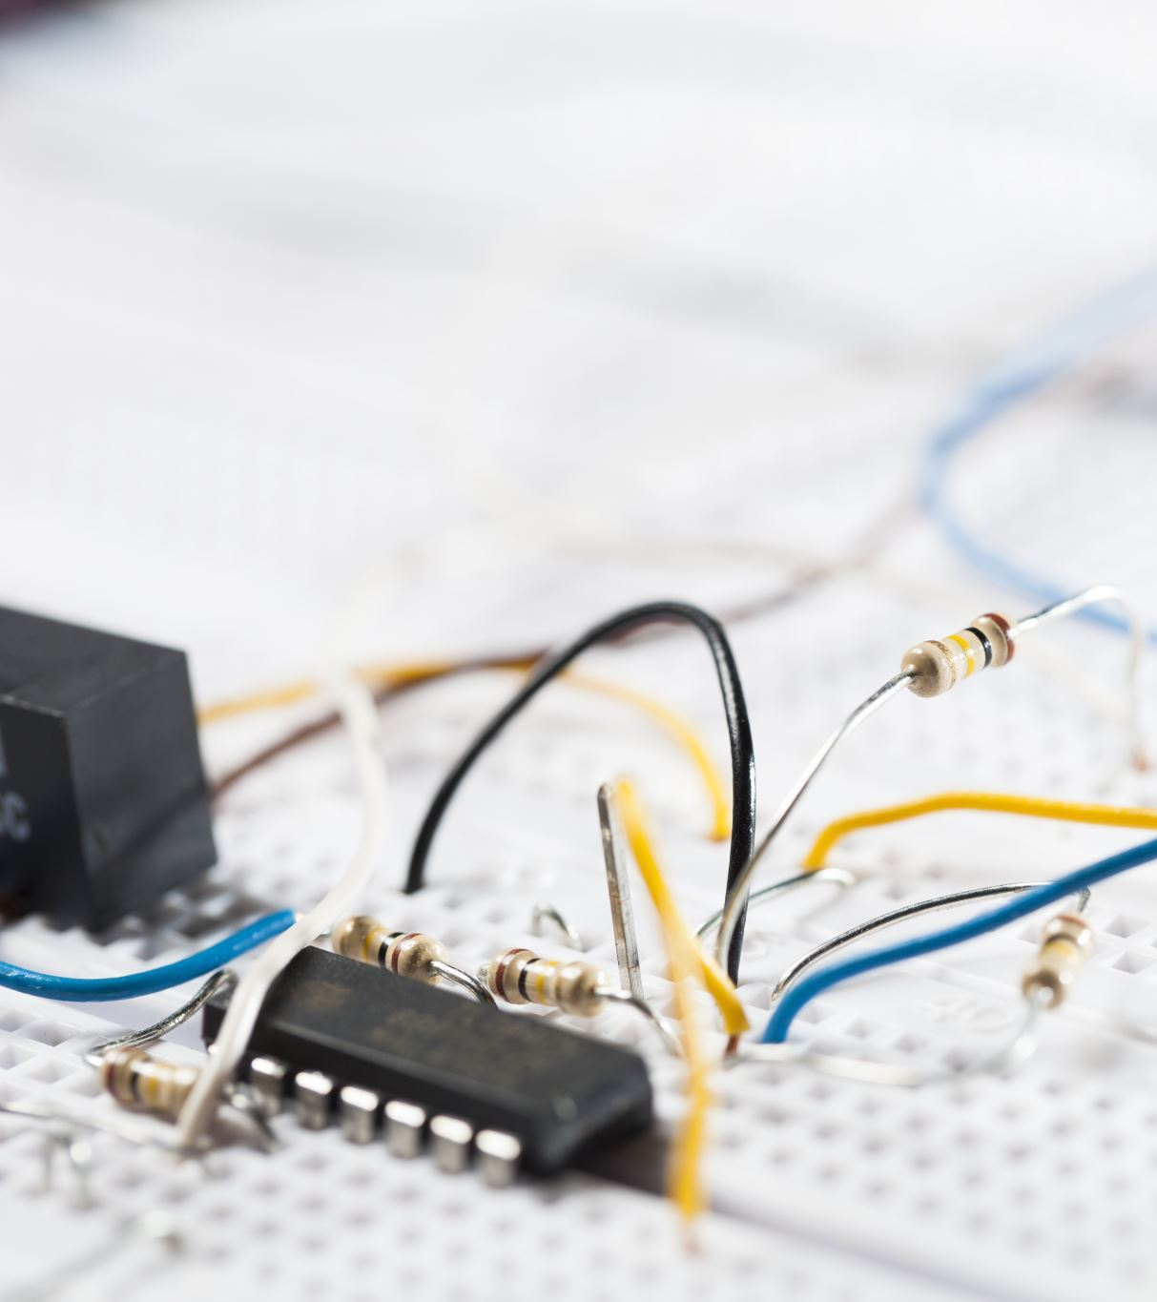
Using Logic Gates
KS 3

Slide 2
LO: Understand how computers use binary to make a decision
AO3 Predict the output of Boolean Decisions
AO2 Describe how binary numbers can represent Boolean decisions using truth tables
AO1 List the outputs of logic gates

Slide 3
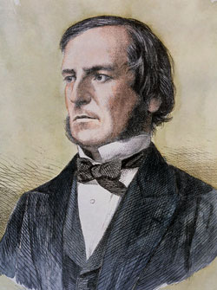
All very logical!
Activity 1
George Boole was an English mathematician who lived in the 1800s.
In 1847 he wrote a book called The Mathematical Analysis of Logic, in which he introduced Boolean algebra which used the logical states of True or False.
Notes:
This is just for background information for students, they do not need to take notes. Link the True and False to binary from the starter.
Image source: https://en.wikipedia.org/wiki/George_Boole#/media/File:George_Boole_color.jpg

Slide 4
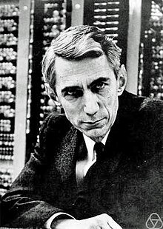
All very logical!
Activity 1
Later in 1940 Claude Shannon discovered that Boolean algebra could be applied to electrical circuits.
The True and False values could also be represented as 1 and 0.
Shannon’s discovery forms the basis of all electronic computers.
Notes:
This is just for background information for students, they do not need to take notes. Link the True and False to binary from the starter.
Image source: https://en.wikipedia.org/wiki/Claude_Shannon

Slide 5

All very logical!
Activity 1
All computers have a central processing unit (CPU). The CPU processes the data and instructions for the computer. They uses microscopic switches to make circuits which are either ON or OFF
This processing uses billions of tiny electronic components to carry out operations called logic gates.
Notes:
Image source: https://pixabay.com/vectors/statistic-wordpress-web-data-1820320/
Suggested activity: Learners to make notes about this theory in their book as you explain that this unit look at the very heart of the computer system: the logic gates that are the building blocks of the CPU.

Slide 6






LO: Understand how computers use binary to make a decision
Video – how to electrical circuits work?
How do we tell the switch is open or closed?
Make the diagram using these symbols and write the table in a Word doc
https://youtu.be/zc59TXKAPio

Slide 7
All very logical!
Activity 1
George Boole's idea was that statements could be used to make logical decisions:
IF raining = true AND cold = true THEN wear a coat = true
TRY THESE:
IF age < 18 = true AND film certificate is 18 = true THEN watch film = ???
IF day NOT = Friday THEN chips in canteen = ????
IF noise is BARK = true OR legs < 3 = true THEN is cat = ???
WRITE YOUR OWN LOGIC DECISION
Notes:
This is just for background information for students, they do not need to take notes. Link the True and False to binary from the starter.
Image source: https://en.wikipedia.org/wiki/George_Boole#/media/File:George_Boole_color.jpg

Slide 8


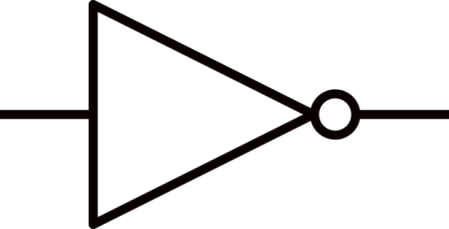
The three fundamental gates
Activity 1
There are three fundamental logic gates. These are AND, OR, and NOT. These are used inside of circuits in the CPU to carry out the decisions like we have made on the last slide
We can use them simply with an input (a power supply) to control a bulb
We are now going to use the website https://logic.ly/demo/ to carry out some experiments and record the results
Screen shot your circuit as you make it
AND
OR
NOT

Slide 9
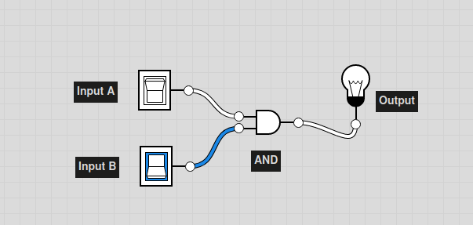
EXAMPLE
Activity 1
Build the circuit so an AND gate has two switches as inputs (A at the top)
When a switch it ON it will go blue, like input B in this example
When the bulb is on it will turn blue also
In this example we can see that A is OFF AND B is ON so the OUTPUT is OFF

Slide 10

Truth table: AND
Activity 2
Draw the circuit
Then all possible input combinations are then entered into the truth table.
Use the bulb to record if the output is off (0) or on (1)
What was the rule for the AND gate? How does the table prove it?
Notice the order in which the values are entered: 0, 1, 2, 3.
Inputs |  | Output
A | B | Q
0 | 0 | 0
0 | 1 | 0
1 | 0 | 0
1 | 1 | 1

Slide 11
Truth table: OR
Activity 2
Here is a truth table for the OR gate.
Draw the circuit
Then all possible input combinations are then entered into the truth table.
Use the bulb to record if the output is off (0) or on (1)
What was the rule for the OR gate? How does the table prove it?
Inputs |  | Output
A | B | Q
0 | 0 | 0
0 | 1 | 1
1 | 0 | 1
1 | 1 | 1
A
Q
B

Slide 12

Truth table: NOT
Activity 2
Complete the NOT truth table
What was the rule for the AND gate? How does the table prove it?
Input | Output
A | Q
0 | 1
1 | 0
A
Q

Slide 13
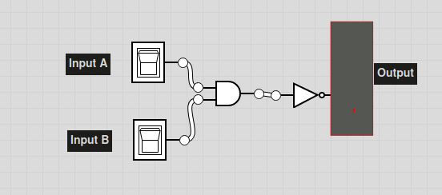
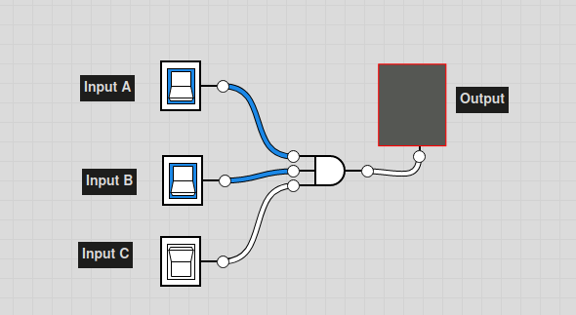
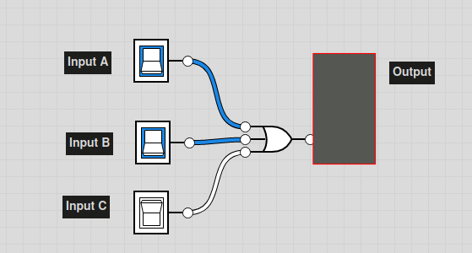
Challenge
not (A and B)
= (not A) or (not B) Should be on
Write down what you think the output of the bulb will be under each one
Build the circuit
Check if you are correct. If not, can you say why???
(A and B) and C Should be off
(A or B) or C Should be on

